Slide 1
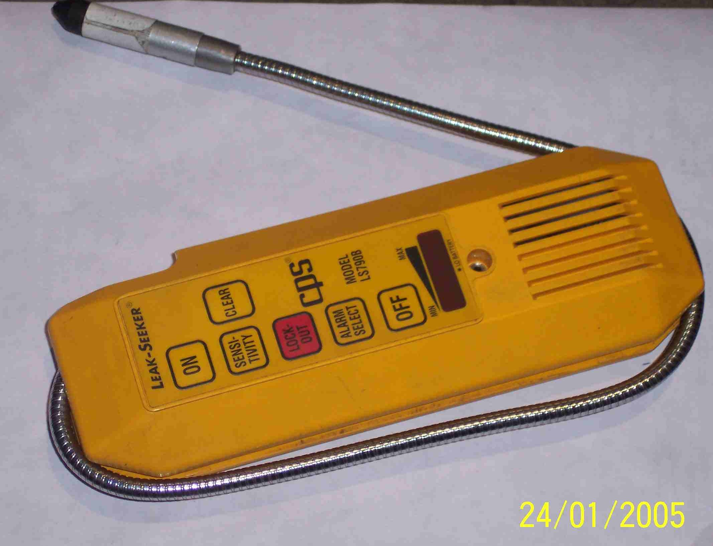
SIEMENS
HVCB SPARES
SF6 Leakage detector
S4799097001

